Slide 1
String Handling
String is a non primitive data type which refers to an object.
String is basically an object that represents sequence of char values.
char[] ch={'j','a','v','a'};
String s=new String(ch);
is same as:
String s="java";
Java String class provides a lot of methods to perform operations on strings such as compare(), concat(), equals(), split(), length(), replace(), compareTo(), intern(), substring() etc.

Slide 2
String Handling
Generally, String is a sequence of characters.
But in Java, string is an object that represents a sequence of characters.
The java.lang.String class is used to create a string object.
How to create a string object?
There are two ways to create String object:
By string literal
By new keyword

Slide 3
String Handling
Heap Memory
The heap memory is a run time data area from which the memory for all java class instances and arrays is allocated.
The heap is created when the JVM starts up and may increase or decrease in size while the application runs.
By default, the maximum heap size is set to 64 MB.
String Constant Pool
String uses a special memory location to reuse of String objects called String Constant Pool.
String objects created without the use of new keyword are stored in the String Constant Pool part of the heap.
One of the important characteristics of String constant pool is that it does not create the same String object if there is already String constant in the pool

Slide 4

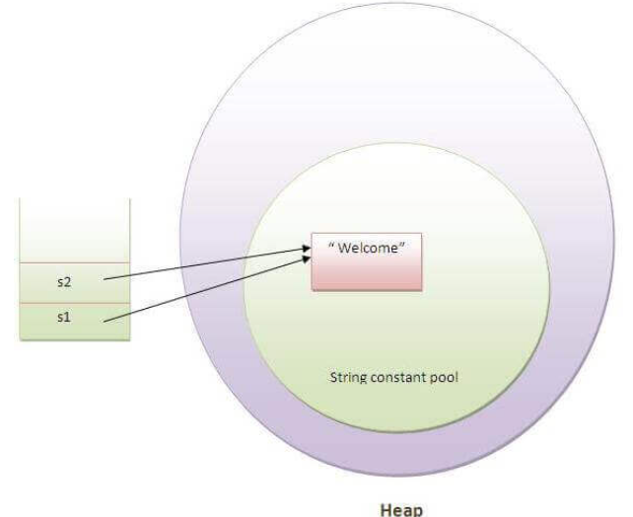
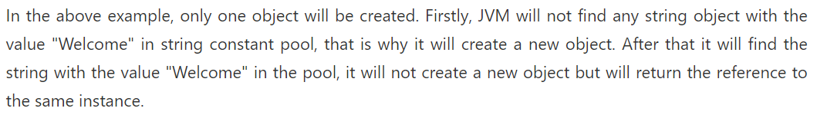
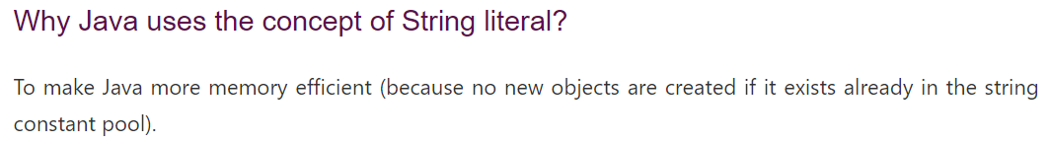
String Handling
1) String Literal
Java String literal is created by using double quotes. For Example: String s="welcome";
Each time you create a string literal, the JVM checks the "string constant pool" first.
If the string already exists in the pool, a reference to the pooled instance is returned.
If the string doesn't exist in the pool, a new string instance is created and placed in the pool.

Slide 5
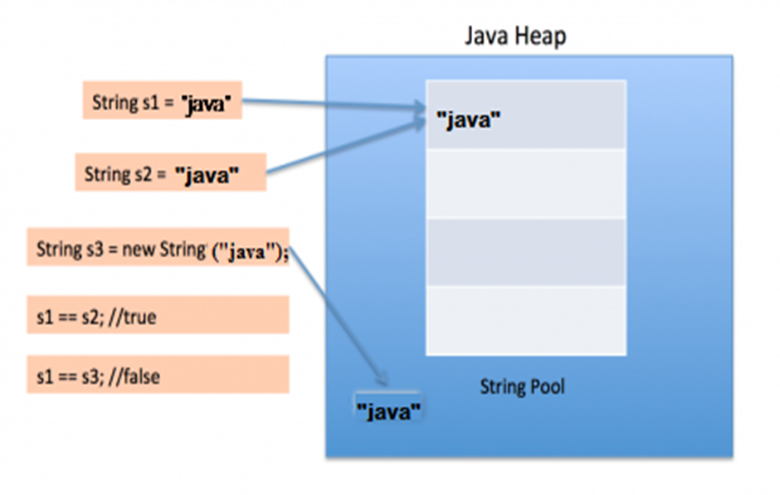
String Handling
2) By new keyword
String s=new String("Welcome");//creates two objects and one reference variable
In such case, JVM will create a new string object in normal (non-pool) heap memory, and the literal "Welcome" will be placed in the string constant pool. The variable s will refer to the object in a heap (non-pool).

Slide 6
String Handling
2) By new keyword
How many strings are getting created in the below statement;
String str = new String("Cat");
In the above statement, either 1 or 2 string will be created. If there is already a string literal “Cat” in the pool, then only one string “str” will be created in the heap. If there is no string literal “Cat” in the pool, then it will be first created in the pool and then in the heap space, so a total of 2 string objects will be created.

Slide 7
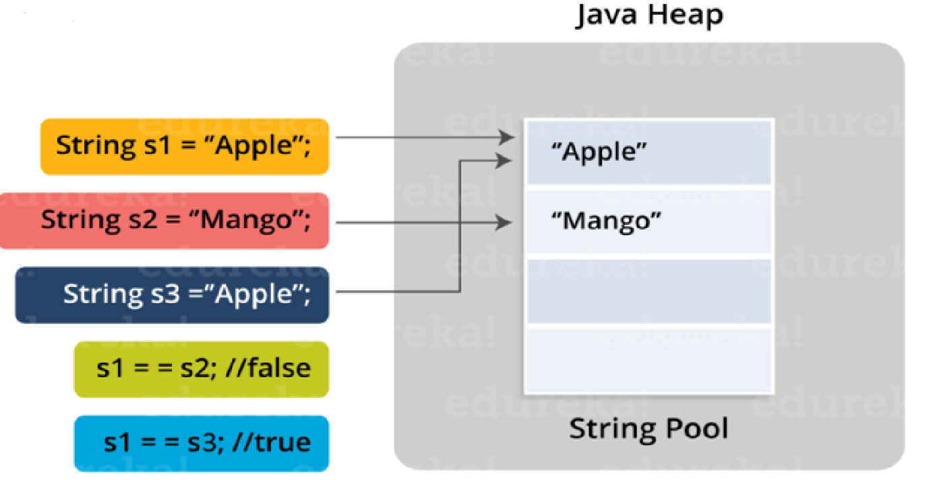
String Handling
JVM looks for all the string literals in the program
First, it finds the variable s1 which refers to the literal “Apple” and it gets created in the memory
A reference for the literal “Apple” is then placed in the string constant pool memory.
Then it finds another variable s2 which refers to the same string literal “Mango”.
Then it finds another variable s3 which refers to the literal “Apple”
Now that JVM has already found a string literal “Apple”, both the variables s1 and s3 will refer to the same object i.e. “Apple”.

Slide 8
String Handling
Immutable String in Java
In java, string objects are immutable. Immutable simply means unmodifiable or unchangeable.
Once string object is created its data or state can't be changed but a new string object is created.
Why string objects are immutable in java?
Because java uses the concept of string literal.
Suppose there are 5 reference variables, all refers to one object "sachin".If one reference variable changes the value of the object, it will be affected to all the reference variables. That is why string objects are immutable in java.

Slide 9
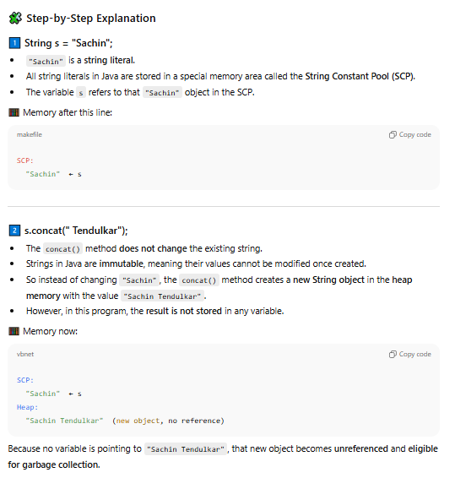
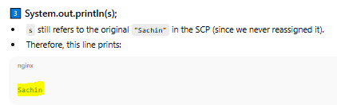
class Testimmutablestring{
public static void main(String args[]){
String s="Sachin";
s.concat(" Tendulkar");//concat() method appends the string at the end
System.out.println(s);//will print Sachin because strings are immutable objects
}
}

Slide 10
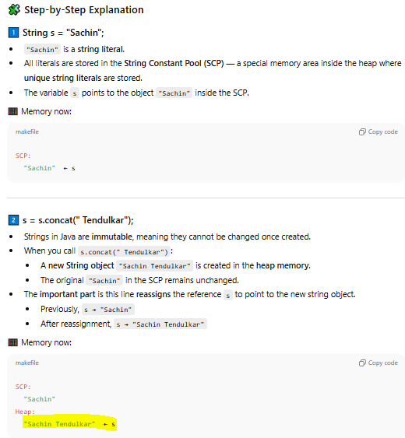
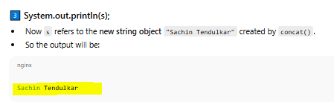
class Testimmutablestring1 {
public static void main(String args[]) {
String s = "Sachin";
s = s.concat(" Tendulkar");
System.out.println(s);
}
}

Slide 11
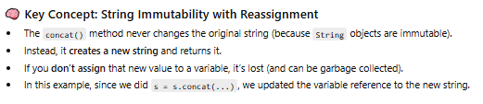

Slide 12
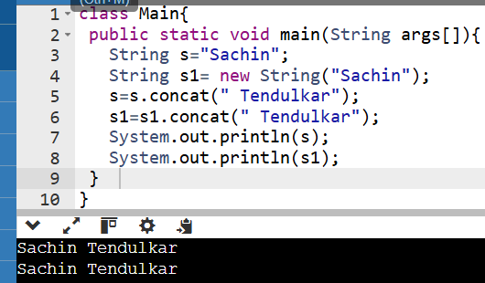
Explain the memory assignment of s and s1…

Slide 13
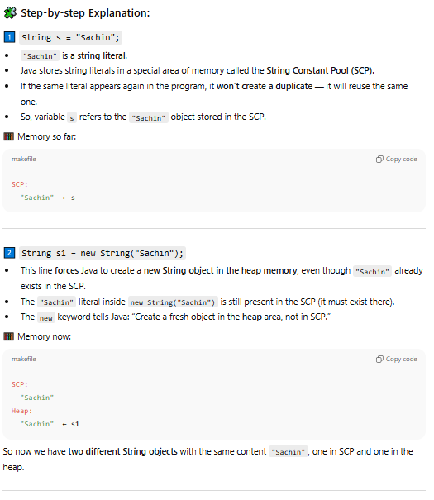
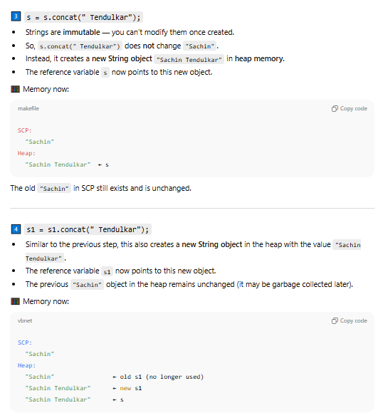

Slide 14
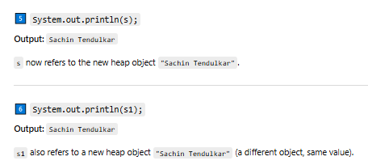

Slide 15
String Handling
public class StringExample{
public static void main(String args[]){
String s1="java";//creating string by java string literal
char ch[]={'s','t','r','i','n','g','s'};
String s2=new String(ch);//converting char array to string
String s3=new String("example");//creating java string by new keyword
System.out.println(s1);
System.out.println(s2);
System.out.println(s3);
}}

Slide 16
String Handling
If modifiable string is desired, Java provides two options: StringBuffer and StringBuilder.
Both hold strings that can be modified after they are created.
The String, StringBuffer, and StringBuilder classes are defined in java.lang.

Slide 17
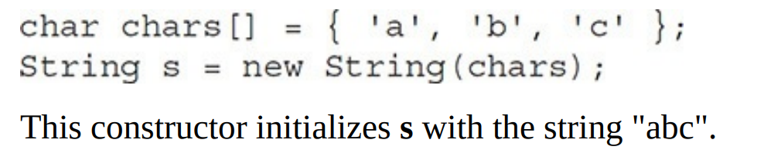
String Handling
String Constructors
The String class supports several constructors.
To create an empty String, call the default constructor.
String s = new String();
will create an instance of String with no characters in it.
To create a String initialized by an array of characters, use the constructor shown here:
String(char chars[ ])

Slide 18
String Handling
String Constructors
You can specify a subrange of a character array as an initializer using the following constructor:
String(char chars[ ], int startIndex, int numChars)
Here, startIndex specifies the index at which the subrange begins, and numChars specifies the number of characters to use.
char chars[] = { 'a', 'b', 'c', 'd', 'e', 'f' };
String s = new String(chars, 2, 3);
This initializes s with the characters cde.
You can construct a String object that contains the same character sequence as another String object using this constructor:
String(String strObj)
Here, strObj is a String object.

Slide 19
String Handling
String Constructors
// Construct one String from another.
class MakeString {
public static void main(String args[]) {
char c[] = {'J', 'a', 'v', 'a'};
String s1 = new String(c);
String s2 = new String(s1);
System.out.println(s1);
System.out.println(s2);
}
}
The output from this program is as follows:
Java
Java

Slide 20
String Handling
String Length
The length of a string is the number of characters that it contains.
To obtain this value, call the length( ) method, shown here:
int length( )
The following fragment prints “3”, since there are three characters in the string s:
char chars[] = { 'a', 'b', 'c' };
String s = new String(chars);
System.out.println(s.length());

Slide 21
String Handling
char chars[] = { 'a', 'b', 'c' };
String s1 = new String(chars);
String s2 = "abc"; // use string literal
Because a String object is created for every string literal, you can use a string literal any place you can use a String object. For
System.out.println("abc".length());

Slide 22
String Handling
String Concatenation
The following fragment concatenates three strings:
String age = "9";
String s = "He is " + age + " years old.";
System.out.println(s); //This displays the string “He is 9 years old.”

Slide 23
String Handling
String Concatenation with Other Data Types
You can concatenate strings with other types of data. Consider the following:
String s = "four: " + 2 + 2;
System.out.println(s);
This fragment displays
four: 22
rather than the
four: 4
String s = "four: " + (2 + 2);
Now s contains the string “four: 4”.

Slide 24
String Handling
string concatenation forms a new string that is the combination of multiple strings. There are two ways to concat string in java:
By + (string concatenation) operator
By concat() method
1) String Concatenation by + (string concatenation) operator
Java string concatenation operator (+) is used to add strings. For Example:
class TestStringConcatenation1{
public static void main(String args[]){
String s="Sachin"+" Tendulkar";
System.out.println(s);//Sachin Tendulkar
}
}

Slide 25
String Handling
class TestStringConcatenation2{
public static void main(String args[]){
String s=50+30+"Sachin"+40+40;
System.out.println(s);//80Sachin4040
}
}

Slide 26
String Handling
2) String Concatenation by concat() method
The String concat() method concatenates the specified string to the end of current string.
Syntax:
public String concat(String another)
class TestStringConcatenation3{
public static void main(String args[]){
String s1="Sachin ";
String s2="Tendulkar";
String s3=s1.concat(s2);
System.out.println(s3);//Sachin Tendulkar
}
}

Slide 27
String Handling
String Conversion and toString( )
toString( )
It is the means by which you can determine the string representation for objects of classes that you create.
The toString( ) method has this general form:
String toString( )
To implement toString( ), simply return a String object that contains the human-readable string that appropriately describes an object of your class

Slide 28
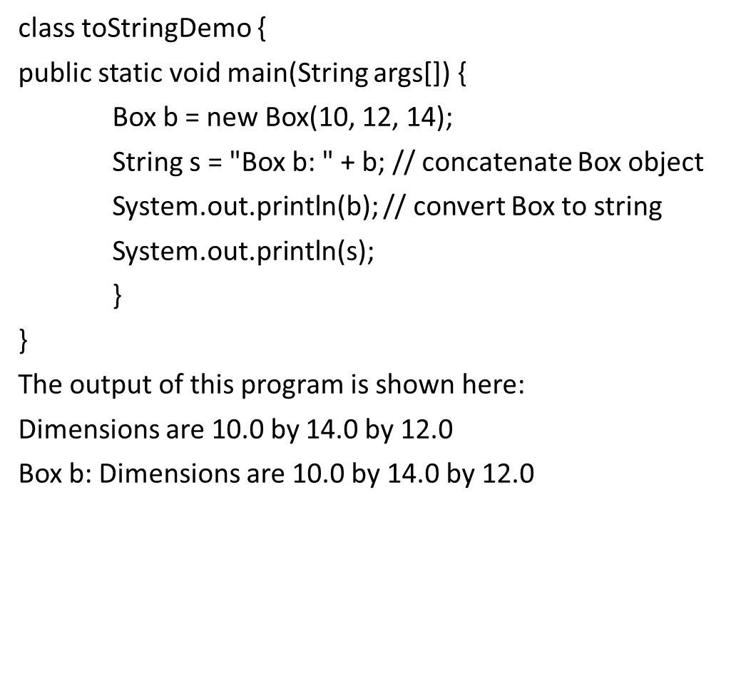
String Handling
The following program demonstrates this by overriding toString( ) for the Box class:
class Box {
double width;
double height;
double depth;
Box(double w, double h, double d) {
width = w;
height = h;
depth = d;
}
public String toString() {
return "Dimensions are " + width + " by " +depth + " by " + height + ".";
}
}

Slide 29
Character Extraction
The String class provides a number of ways in which characters can be extracted from a String object.
charAt( )
char charAt(int where)
Here, where is the index of the character that you want to obtain. The value of where must be nonnegative and specify a location within the string.
char ch;
ch = "abc".charAt(1);
assigns the value “b” to ch.
getChars( )
If you need to extract more than one character at a time, you can use the getChars( ) method.
It has this general form:
void getChars(int sourceStart, int sourceEnd, char target[ ], int targetStart)
sourceStart specifies the index of the beginning of the substring, and sourceEnd specifies an index that is one past the end of the desired substring.
Thus, the substring contains the characters from sourceStart through sourceEnd–1.
The array that will receive the characters is specified by target.
The index within target at which the substring will be copied is passed in targetStart.

Slide 30
class getCharsDemo {
public static void main(String args[]) {
String s = "This is a demo of the getChars method.";
int start = 10;
int end = 14;
char buf[] = new char[end - start];
s.getChars(start, end, buf, 0);
System.out.println(buf);
}
}
Here is the output of this program:
demo

Slide 31
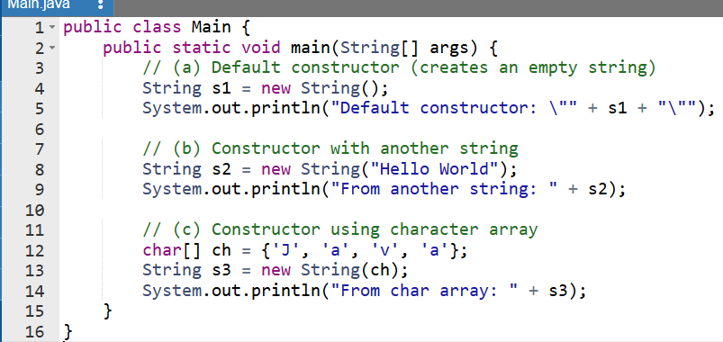

Slide 32
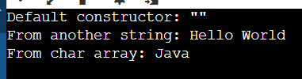

Slide 33
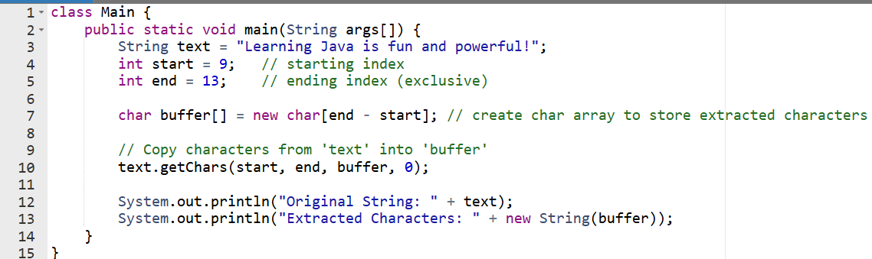

Slide 34
